Slide 1
CSE1906- Mini Project First Review​
CSRNet and DeepLift XAI for Explainable Steganalysis​
Presented by​
Sakthi Sairam. U, 21MIA1087​
Guided BY
Dr. Sivakumar P

Slide 2
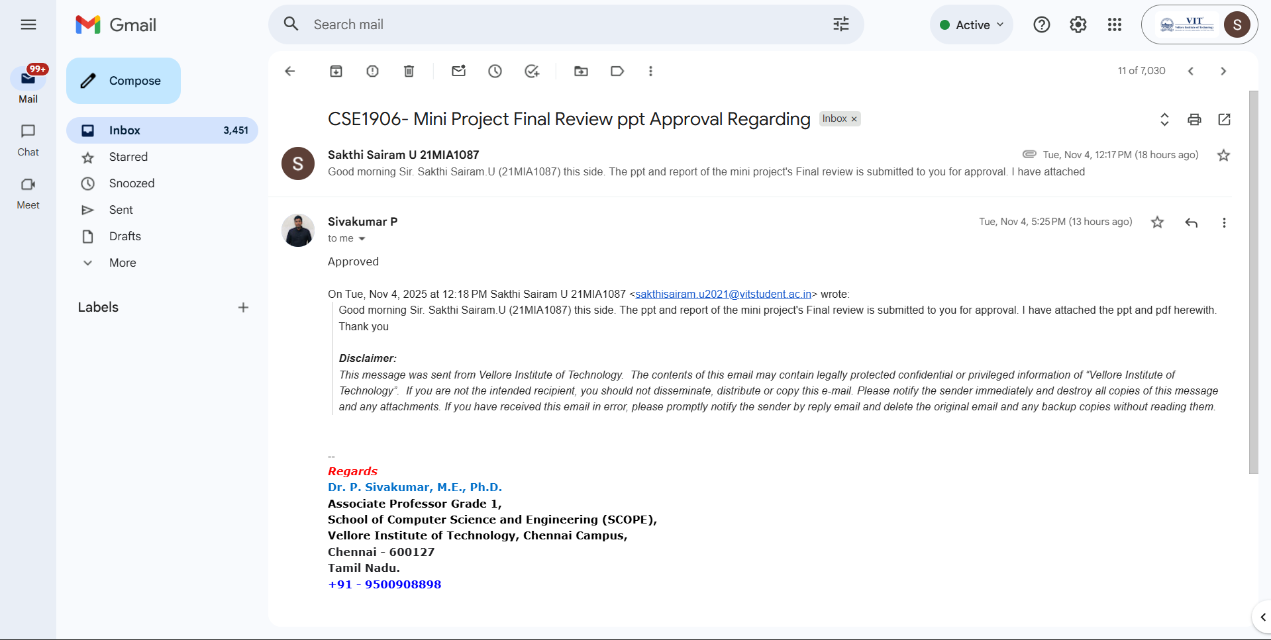

Slide 3
Outline
Introduction
Literature Review
Scope and Problem Statement
Research Objective and Challenges
Methodology
Results and Discussion
Conclusion
Limitations and Future Work
References

Slide 4
Introduction
Steganography: The technique of hiding secret data within a digital media (commonly images).
Steganalysis: The process of detecting whether an image contains hidden data.
It has valid uses, such as copyright protection, secure communication, it is also misused for secret cyberattacks and illegal data transfers.
Why Steganalysis Matters:
Crucial for cybersecurity, intelligence, law enforcement, and digital forensics.
Steganography is increasingly used for covert communication in cybercrimes.
Traditional vs. Deep Learning Approaches:
Handcrafted feature-based steganalysis is limited in adaptability and scalability.
Deep CNNs (e.g., CSRNet) have significantly detection performance.
Explainable AI (XAI) Importance:
Need for visual and interpretable explanation of model predictions.

Slide 5
Literature Review
S. No. | Author(s), Year | Method/Approach | Key Contribution | Gaps Identified
1 | Ma, Y., Yang, Z., Li, T., Xu, L., & Qiao, Y. (2023) | Use of CS & residual networks with adaptive filtering to improve feature extraction. | Improved detection accuracy by combining an adaptive filtered residual network with intelligent cover image selection to better capture hidden message traces. | Limited testing on diverse, real-world images; generalization to various stego methods unverified.
2 | Shehab, D. A., & Alhaddad, M. J. (2022) | Broad taxonomy of steganalysis techniques across image, audio, and video & evaluation metrics discussed. | Overview of multimedia steganalysis methods, emphasizing comparative analyses, and potential avenues for future study in a range of media formats. | Lacks deep focus on modern deep learning techniques and energy efficiency; minimal coverage of adversarial robustness.
3 | Kheddar, H., Hemis, M., Himeur, Y., Megias, D., & Amira, A. (2024) | Extensive survey of DL-based steganalysis methods and data types; taxonomy and challenge identification. | Critical evaluation of deep learning-based steganalysis techniques for a variety of data kinds, pointing out present issues and suggesting directions for further study. | Emphasis still on images; minimal solutions for evolving steganographic threats; interpretability not addressed.
4 | Zhu, Y., Wang, X., Chen, H. S., Salloum, R., & Kuo, C. C. J. (2023) | Focus on energy-efficient steganalysis using lightweight models. | “Green learning" framework for image steganalysis that preserves high detection performance while drastically cutting down on computational expenses. | Green learning still early-stage; performance trade-offs not deeply explored; lacks large-scale validation.
5 | Gupta, A., Chhikara, R., & Sharma, P. (2024) | Development of a compact and efficient CNN (CIRNet) for universal steganalysis. | CIRNet, which has inverted residuals and provides reliable and effective universal steganalysis for a variety of stego techniques and payloads. | Optimization for edge devices needs more validation; vulnerability to adversarial attacks unexplored.
Notes:
1. GLCM and IPLF
3. CNN, LSTM, DNN, RNN
4. Less computational cost and carbon footprint
5. Inverted residuals for feature extraction

Slide 6
S. No. | Author(s), Year | Method/Approach | Key Contribution | Gaps Identified
6 | Kuznetsov, O., Frontoni, E., Chernov, K., Kuznetsova, K., Shevchuk, R., & Karpinski, M. (2024) | Fine-tuning of deep residual networks for spread spectrum steganography detection. | By optimizing a deep residual network, it was possible to improve the detection of spread spectrum image steganography, demonstrating AI's efficacy in steganalysis under difficult circumstances. | Specific to spread spectrum methods; lacks generalization to other stego types or unseen embedding algorithms.
7 | Shrikumar, A., Greenside, P., & Kundaje, A. (2017, July) | Introduces DeepLIFT for feature importance and model interpretability in neural networks. | DeepLIFT, a novel feature attribution technique, effectively finds significant input features in neural networks and improves the interpretability of the model. | Not directly applied to steganalysis; integration of interpretability into security-critical models remains limited.
8 | Huang, S., Zhang, M., Ke, Y., Bi, X., & Kong, Y. (2022) | Attention mechanisms improve spatial feature sensitivity in steganalysis. | Attention-augmented convolutional model that improves steganalysis by concentrating on areas that are sensitive to stego, which results in a more precise identification of hidden data. | Computationally intensive; real-time applications not addressed; dataset diversity could be improved.
9 | Gao, X., Yi, J., Liu, L., & Tan, L. (2025) | Use of big data matching and improved ResNet50 for generic steganalysis. | Steganalysis framework to increase the generalization and precision of hidden image detection by fusing an improved ResNet50 architecture with big data-based pattern matching. | Scalability to dynamic datasets not clear; lacks testing on resource-constrained environments.
10 | Mhawi, M. Y., Abdullah, H. N., & Sikora, A. (2024) | Overview of how GANs can generate and detect steganographic images. | Highlighted significant developments, difficulties, and unmet research needs in the field of image security using GANs, specifically in steganalysis. | Little discussion on GAN resistance to adversarial samples; no exploration of training stability or ethics.

Slide 7
S. No. | Author(s), Year | Method/Approach | Key Contribution | Gaps Identified
11 | De La Croix, N. J., Ahmad, T., & Han, F. (2024) | By contrasting deep learning-based image steganalysis techniques with conventional methods and examining architectures, datasets, and evaluation metrics, the authors carried out an organized survey of the field. | In addition to summarizing current trends and highlighting performance advantages over conventional approaches, they offered a taxonomy of DL-based steganalysis techniques. | Poor detection at low payloads, limited generalization, high computational costs, interpretability issues, and little attention to payload localization are some of the main shortcomings.
12 | Eid, W. M., Alotaibi, S. S., Alqahtani, H. M., & Saleh, S. Q. (2022) | Using both conventional ML and DL models, the authors examined steganalysis methods for both 2D and 3D images, encompassing spatial and transform domain approaches. | In addition to highlighting developments in deep learning, the paper provides a thorough taxonomy of image steganalysis techniques and lists important datasets, metrics, and methodologies. | Weak generalization, low-payload detection difficulty, lack of model explainability, limited 3D image focus, and high computational costs are some of the gaps that have been found.
13 | Bohang, L., Li, N., Yang, J., Alfarraj, O., Albelhai, F., Tolba, A., ... & Yee, P. L. (2025) | The study applies differential evolution for hyperparameter tuning in steganalysis models and combines active learning with deep reinforcement learning to minimize labeling effort. | It demonstrates that combining active learning and optimization improves steganalysis performance on common datasets by achieving high accuracy with fewer labeled samples. | The approach has issues with real-time deployment because of its computational demands, is sensitive to noisy data, and requires some manual labeling.
14 | Farooq, N., & Selwal, A. (2023) | Describes the tools and frameworks available in the literature, compare benchmark datasets and evaluation metrics, and survey different DL models, particularly CNNs. | The article identifies the most popular datasets and metrics, presents an organized taxonomy of DL steganalysis techniques, and outlines unresolved research issues. It summarizes what has been done and what is left. | They highlight a number of shortcomings, including poor performance, particularly when payloads are small or the embedding is subtle; poor generalization across various cover sources or steganography schemes.
15 | Kuchumova, E., Martínez-Monterrubio, S. M., & Recio-Garcia, J. A. (2024) | The study combines LIME and Grad-CAM to offer visual explanations of model decisions and employs EfficientNet for image steganalysis. | It presents STEG-XAI, which enhances interpretability by identifying hidden content and elucidating the image regions that influence the decision. | Generalization is limited because the method is only tested on UERD in JPEG images; issues with explanation accuracy and robustness in the presence of noise also exist.
Notes:
11. CNN, RNN, Hybrid models
12. 3D images
13. Active learning

Slide 8
Scope and Problem Statement
Scope:
Analyze images for presence of hidden data across diverse embedding methods.
Ensure high detection accuracy across various image complexities and transformations.
Provide interpretable results via saliency maps.
Problem Statement:
Deep learning can detect stego content, but the results lack interpretability.
Need a hybrid solution that combines:
  Accurate steganalysis using cover-adaptive CNN architecture (CSRNet).
  Transparent explanations using DeepLift, to show where and why the image was flagged.

Slide 9
Research Objective and Challenges
Develop a robust and explainable steganalysis system that:
Detects hidden data in digital images with high accuracy.
Provides interpretable feedback for forensic or verification purposes.
Use CSRNet to learn residual patterns in cover vs. stego images.
Implement DeepLIFT to visualize input regions contributing to the model’s decision.
Subtle Embedding Signals
Data Imbalance
Cover Diversity
Model Overfitting
Explainability Challenges
Benchmarking Issues

Slide 10
Methodology
1. Dataset Preparation
  BOSSbase v1.01 image dataset with 10k grayscale stego and cover
2. SRM filterbanks and Cover Selection Module
  SRM filterbanks designed to highlight subtle noise-like artifacts and residuals in images, which are often introduced by steganographic embedding
  Analyze image complexity and use of attention strategy to identify potential stego areas.
3. CSRNet Architecture
  Convolutional layers with adaptive filtering to extract fine-grained residuals.
  Residual blocks to capture high-order patterns and suppress cover image content.
  Final classifier layer outputs binary label (cover/stego).
4. Training and Evaluation
    Splitting dataset. Using accuracy, precision, recall for model performance
5. DeepLIFT for Explainability
  Use post-hoc DeepLIFT to compute feature attribution maps.
  Highlights image pixels most responsible for classification (i.e., “why it was predicted as stego”).
  Evaluating XAI

Slide 11
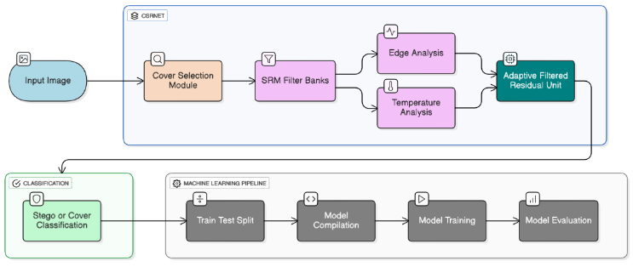
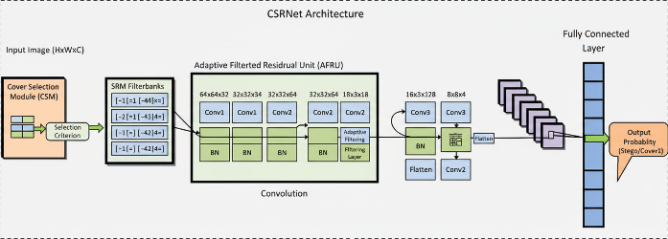

Slide 12
Results and Conclusion
Precision | 0.8635
Accuracy | 0.8821
Recall | 0.8713
F1-Score | 0.8616
Training efficiency:
Cover-selection would reduce training time and improves convergence.
Adaptive filters in CSRNet would capture better noise-residual cues.
Robustness testing:
Expected to maintain performance under jpeg compression, scaling, and rotation.
Experiment | Train-Test- Validation Split | Learning Rate | Batch Size | Validation Accuracy
1 | 60-20-20 | 0.005 | 32 | 0.55
2 | 70-20-10 | 0.002 | 8 | 0.67
3 | 70-20-10 | 0.001 | 16 | 0.74
4 | 80-10-10 | 0.005 | 16 | 0.79
5 | 80-10-10 | 0.001 | 8 | 0.88
Successful design of a steganalysis framework.
Robustness across multiple steganography algorithms and real-world.
Opens path toward trustworthy AI in sensitive image security domains.

Slide 13
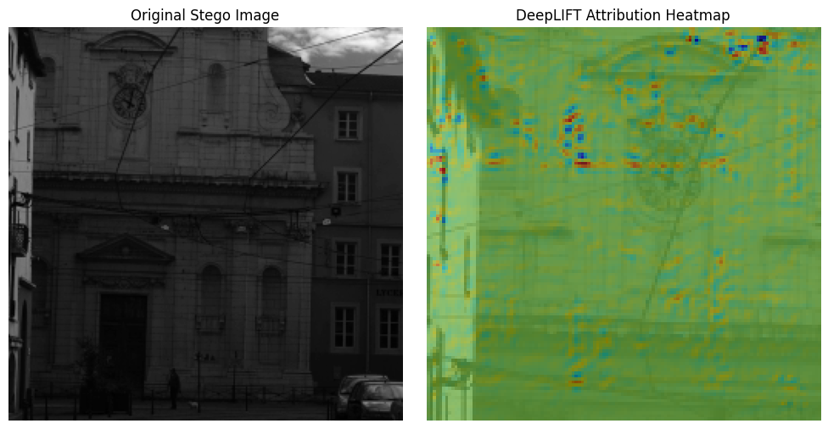
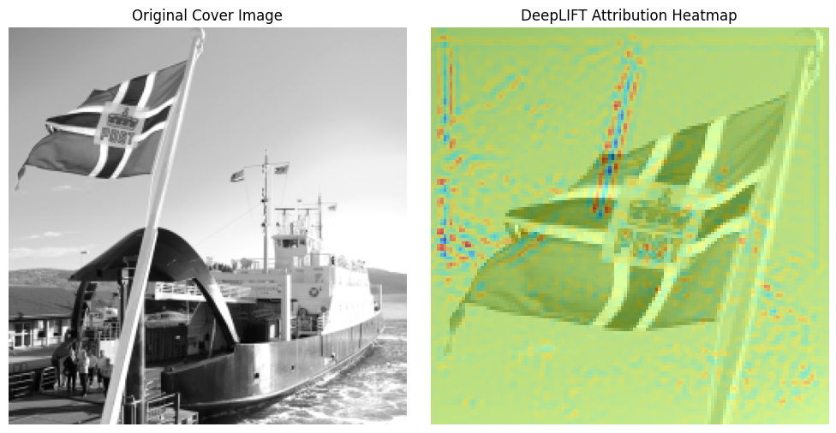
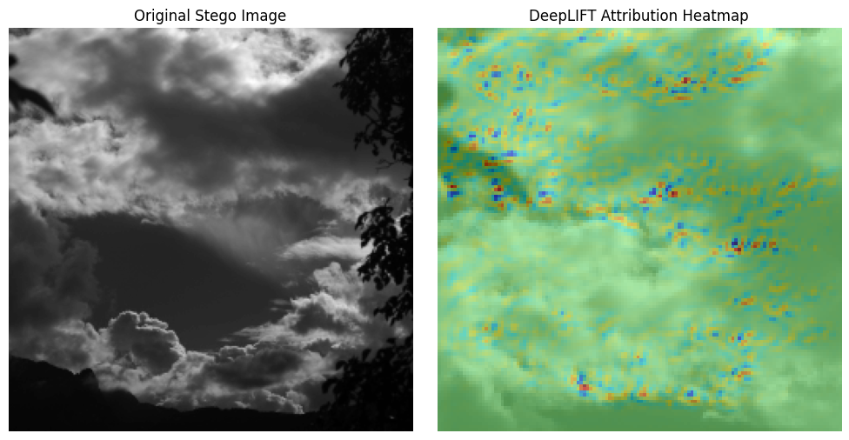
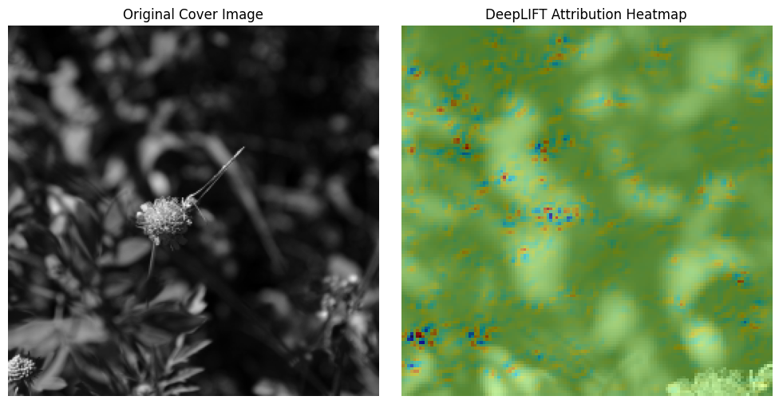
Cont.

Slide 14
Limitations and Future Work
Limitations:
  DeepLift requires a reference baseline; poorly chosen baselines can affect quality.
  Training deep models and generating explanations is compute-intensive.
  Explanations are post-hoc; do not influence training.
  Explanatory visualizations can still be hard to interpret without domain knowledge.
Future Work:
  Explore real-time explainable steganalysis for edge/mobile devices.
  Incorporation in social media and e-mailing forums.
  Investigate end-to-end explainable training, where XAI feedback guides model updates.
  Expand to video and audio steganalysis.
  Incorporate multi-modal learning (text + image steganalysis).
  Validate explanation usefulness through user studies.

Slide 15
References
Ma, Y., Yang, Z., Li, T., Xu, L., & Qiao, Y. (2023). Image steganalysis method based on cover selection and adaptive filtered residual network. Computers & Graphics, 115, 43-54.
Shehab, D. A., & Alhaddad, M. J. (2022). Comprehensive survey of multimedia steganalysis: Techniques, evaluations, and trends in future research. Symmetry, 14(1), 117.
Kheddar, H., Hemis, M., Himeur, Y., Megias, D., & Amira, A. (2024). Deep learning for steganalysis of diverse data types: A review of methods, taxonomy, challenges and future directions. Neurocomputing, 581, 127528.
Zhu, Y., Wang, X., Chen, H. S., Salloum, R., & Kuo, C. C. J. (2023). Green steganalyzer: A green learning approach to image steganalysis. APSIPA Transactions on Signal and Information Processing, 12(1).
Gupta, A., Chhikara, R., & Sharma, P. (2024). CIRNet: An improved lightweight convolution neural network architecture with inverted residuals for universal steganalysis. Arabian Journal for Science and Engineering, 49(9), 12219-12233.
Kuznetsov, O., Frontoni, E., Chernov, K., Kuznetsova, K., Shevchuk, R., & Karpinski, M. (2024). Enhancing Steganography Detection with AI: Fine-Tuning a Deep Residual Network for Spread Spectrum Image Steganography. Sensors, 24(23), 7815.
Shrikumar, A., Greenside, P., & Kundaje, A. (2017, July). Learning important features through propagating activation differences. In International conference on machine learning (pp. 3145-3153). PMlR.
Huang, S., Zhang, M., Ke, Y., Bi, X., & Kong, Y. (2022). Image steganalysis based on attention augmented convolution. Multimedia Tools and Applications, 81(14), 19471-19490.
Gao, X., Yi, J., Liu, L., & Tan, L. (2025). A generic image steganography recognition scheme with big data matching and an improved ResNet50 deep learning network. Electronics, 14(8), 1610.
Mhawi, M. Y., Abdullah, H. N., & Sikora, A. (2024). Gans for image security applications: a literature review. Iraqi Journal of Information and Communication Technology, 7(2), 89-102.

